Slide 1


TASK MANAGEMENT SYSTEM
TEAM MEMBERS :-
YAHNITH - 2200032357
PRAMODH - 2200039022
HARSHITH - 2200030403

Slide 2


INTRODUCTION
A task management tool is used by an individual, team, or organization to complete projects efficiently by organizing and prioritizing related tasks. Task management tools come in many forms, like basic spreadsheets or online project management applications..

Slide 3


Built on the MERN (MongoDB, Express.js, React.js, Node.js) stack for maximum efficiency and scalability.
MongoDB : A NoSQL database for flexible data storage.
Express.js : A fast, unopinionated, minimalist web framework for Node.js.
React.js : A powerful library for building dynamic and responsive user interfaces.
Node.js : Server-side scripting for handling requests.
TECH STACK

Slide 4
CHALLENGES
Challenges with task management systems may include limited features for complex needs, difficulty in scaling as projects grow, customization constraints, support and maintenance burdens, platform dependency, data portability issues, reliability concerns, collaboration limitations, cost-effectiveness challenges, and user
adoption hurdles

Slide 5
WHAT'S IT ALL
Managing tasks just got a whole lot easier! With the Task Management System, you can organize, prioritize, and streamline your workflow effortlessly. This project was born out of a need for a user-friendly, scalable solution to tackle everyday tasks and project management challenges.
ABOUT?

Slide 6


Advantages
Organization: Task management systems provide a structured approach to organizing tasks efficiently.
Efficiency: They streamline workflows and enhance productivity by centralizing task management.
Prioritization: Users can easily prioritize tasks based on
importance and urgency.
Deadline Management: Set deadlines and reminders to ensure timely completion of tasks.
Collaboration: Facilitate teamwork and communication through
task assignment and sharing features.
Visibility: Gain insights into task status and project progress for
Tracking Progress: Monitor task and project progress in real-tim
Resource Allocation: Optimize resource allocation and scheduling based on task dependencies.
Documentation: Serve as a repository for task-related
information, ensuring easy access.
Scalability: Suitable for businesses of all sizes, from small teams to large organizations.
Customization: Tailor the system to specific requirements and workflows for optimal functionality.
TASK MANAGEMENT SYSTEM
better decision-making.
to identify bottlenecks.

Slide 7

Disadvantages
TASK MANAGEMENT SYSTEM
Limited Features: Small task management systems may lack advanced features found in larger solutions, which could limit their effectiveness for complex projects or teams with specific requirements
Customization Constraints: Smaller systems might offer limited customization options, making it challenging to tailor the system to unique workflows or preferences.
Dependency on Single Platform: Some small task management systems may only be available on a single platform or device, limiting accessibility and flexibility for users who prefer to work across multiple devices.

Slide 8

MODULES
SIGN UP/LOG IN:
DASHBOARD
CREATE TASKS
TRACK PROGRESS
TASK ANALYTICS

Slide 9
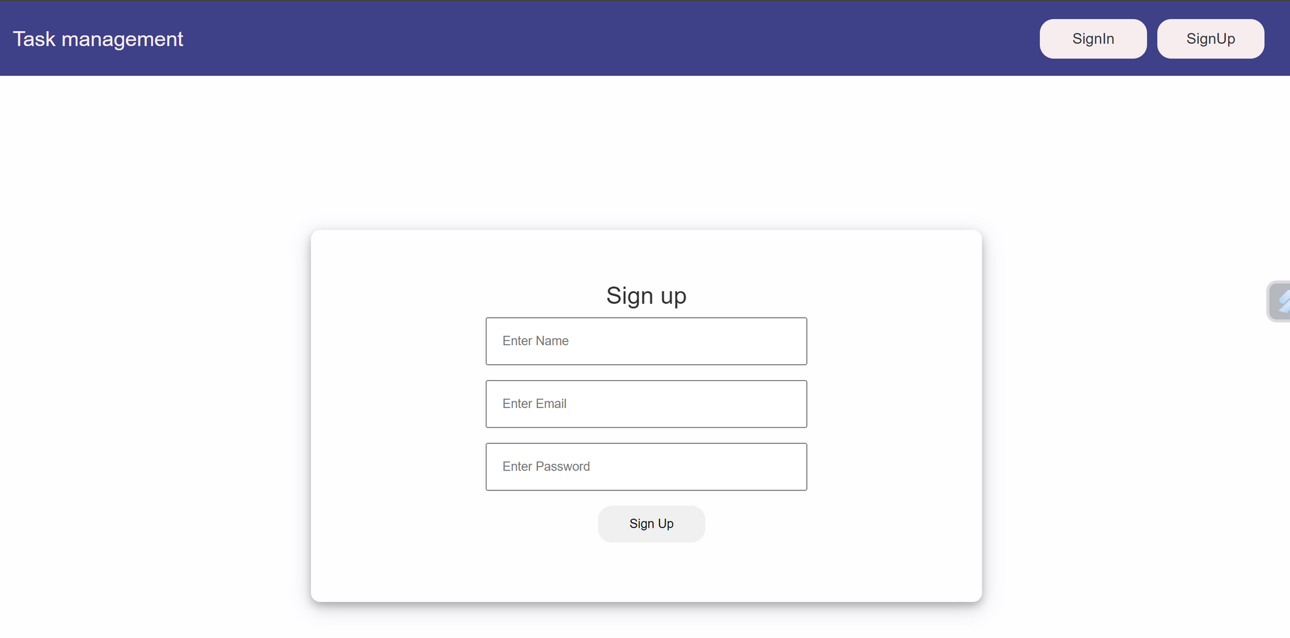
LOGIN PAGE :-

Slide 10
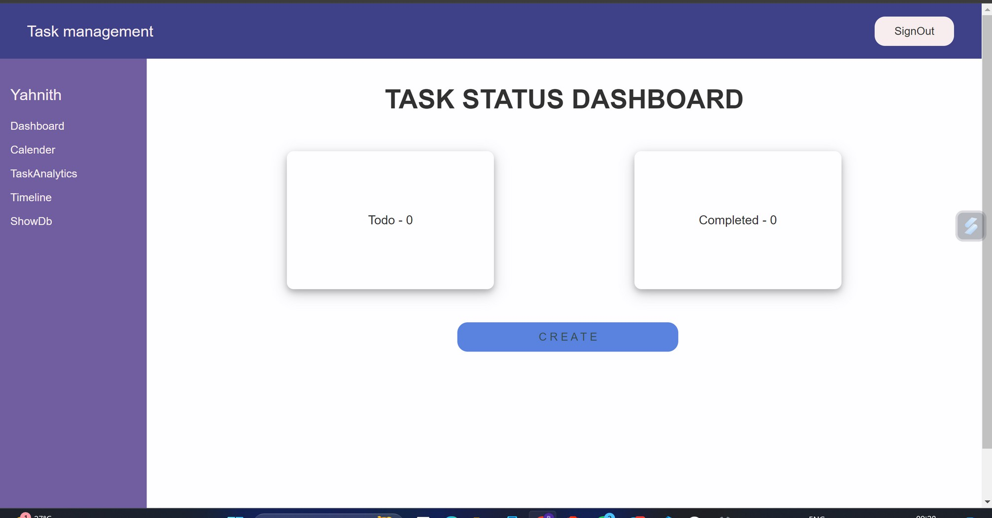
DASHBOARD :-

Slide 11
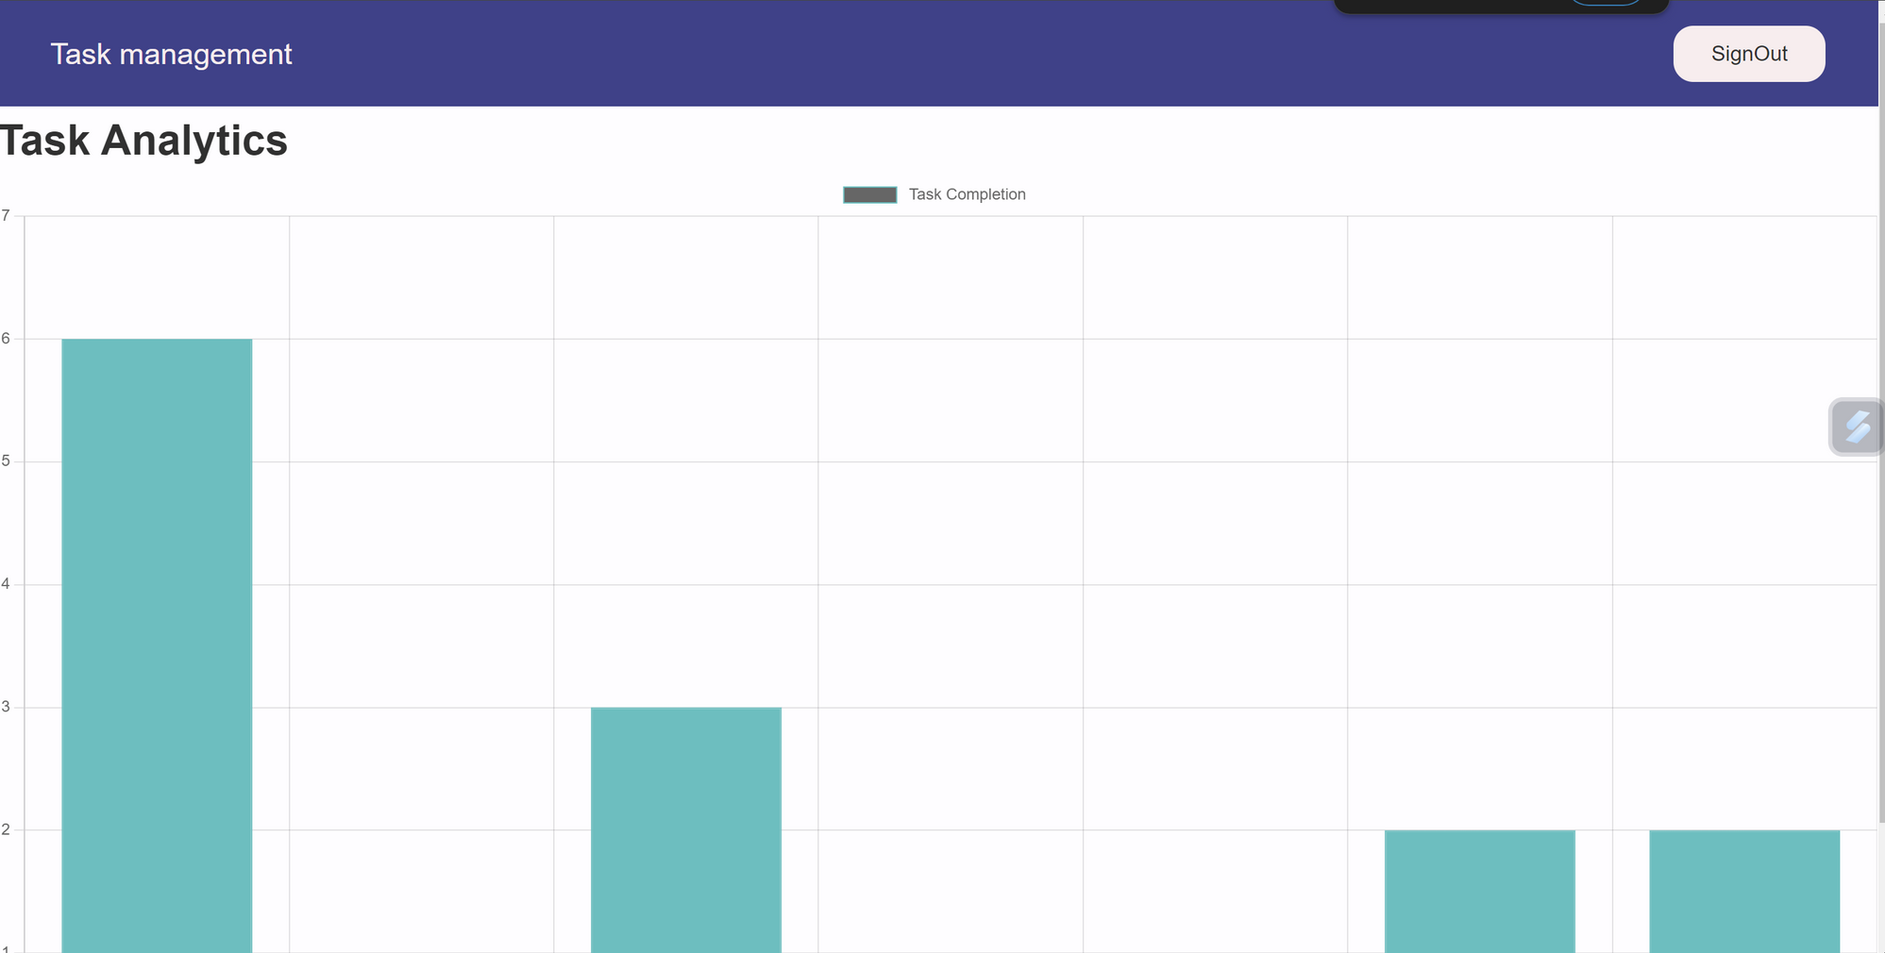
TASK ANALYTICS:-

Slide 12
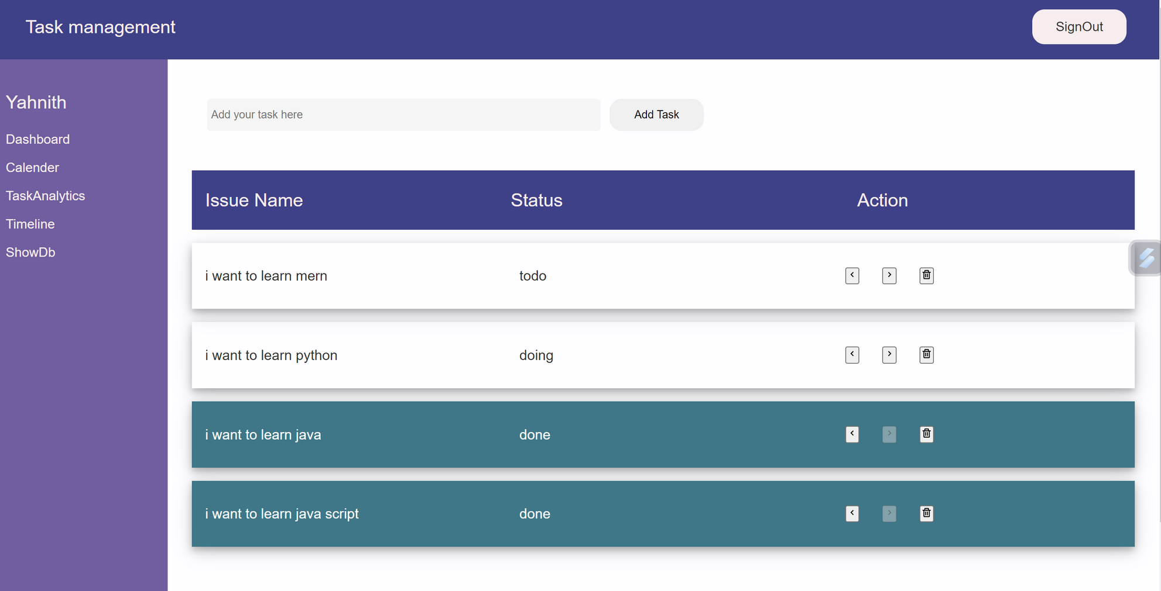
TASK OPERATIONS:-

Slide 13
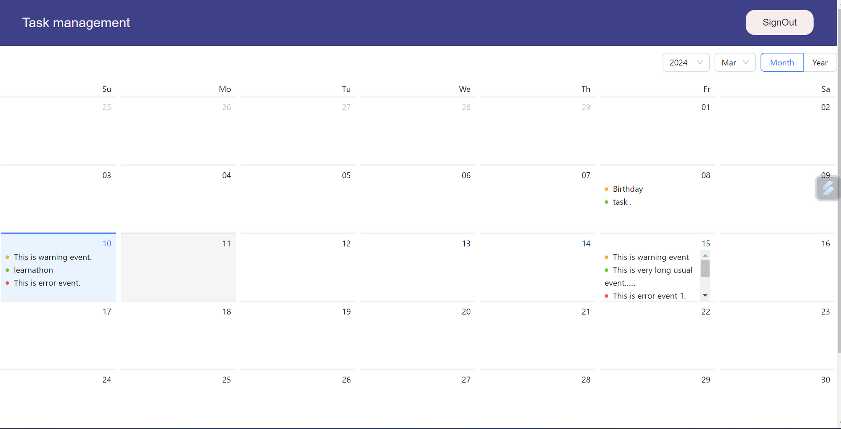
TASK DEADLINES:-

Slide 14
THANK YOU

